Slide 1

Manipal Institute of Technology
CISCO FORECASTING LEAGUE
-Team knighters

Slide 2
Introduction
Problem Statement
Forecasting Importance
To predict the estimated values of the fourth quartile of a company with the knowledge of first three quartiles, using either python model or understanding excel sheets.
Demand Planning teams play a crucial role during uncertain times, like pandemic, by accurately predicting customer demand to ensure orders are fulfilled and inventory levels are optimized.
As a member of the elite Cisco Forecast League, the task is to forecast quarterly demand for 20 critical Cisco products. It's essential to strike a balance as over-forecasting leads to unnecessary material costs, while under-forecasting results in customer dissatisfaction due to unfulfilled orders.
Forecasting algorithms leverage past data to make predictions about future patterns, behaviors, or trends. This capability is invaluable across various sectors, including finance, sales, marketing, healthcare, and meteorology, as it enables organizations to make better-informed decisions and strategic plans.
By forecasting future demand or resource utilization, organizations can optimize their operations, inventory levels, production schedules, and workforce allocation.

Slide 3




About Us:-
Harsh Gupta
Reg No: 210968130
Branch: DSE
Joy Podder
Reg No: 210962184
Branch: CSE AIML
Anurag Kasat
Reg No: 210962180
Branch: CSE AIML
Parshva Dedhia
Reg No: 210968156
Branch: DSE

Slide 4


Challenges
Data preprocessing
Data preprocessing refers to the preparation and transformation of raw data into a format suitable for analysis or modeling. Raw data often contains inconsistency, outliers, missing value etc., these problems are solved with the help of data cleaning.
Model Selection
Model selection plays a vital role in predicting precise and accurate value, Hence which model is to be selected and why so that we get more accurate values. During model creation, our team developed different model, but had to choose a model which are closer to the company’s predicted values.

Slide 5

01
Excel exponential forecasting
ARIMA - Statistical model for time series forecasting.
02
03
Holt's Exponential Smoothing - Extends data smoothing to capture trends and seasonality in time series.
Prediction
techniques
04
Seasonal Arima- Extension of ARIMA
05
2023 Q4 sales predictions using weighted average of Demand Planners, Marketing Teams, and Statistics/ML. forecasts

Slide 6

Analyzing Data

Slide 7
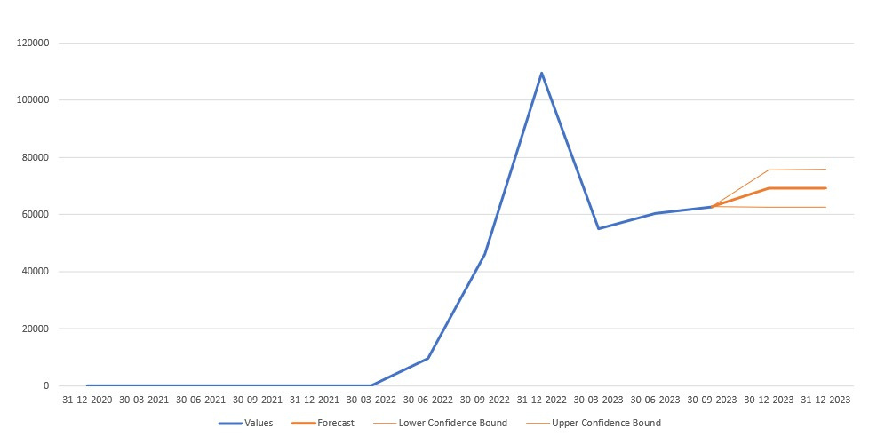
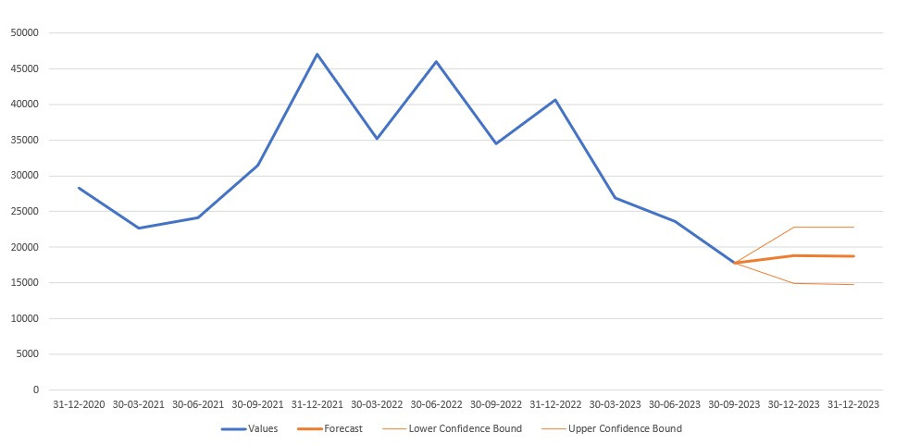
Graphical Analysis
Access Point 2
Power Supply 2
X-Axis (Time): The x-axis represents dates from “31-12-2020” to “31-12-2023”.
Y-Axis (Values): The y-axis has sales values .
Values (Blue): This line shows the historical sales numbers.
Forecast (Orange): A forecast is made for the quarter 4 i.e till 31-12-2023
Lower Confidence Bound (grey): This line indicates the lower limit of the forecast.
Upper Confidence Bound (grey): This line indicates the upper limit of the forecast.

Slide 8
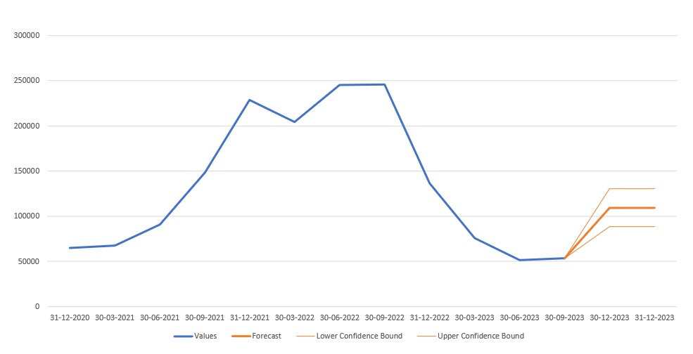
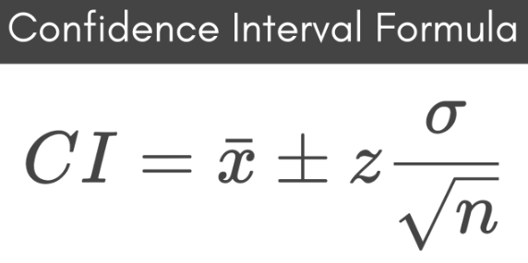
Insights From Analysis:-
Conducted time series visualization for data analysis.
Calculated confidence intervals to determine upper and lower bounds for predicted values.
Computed the average of the upper and lower bounds to obtain a set of forecasted values.
Access Point 3

Slide 9
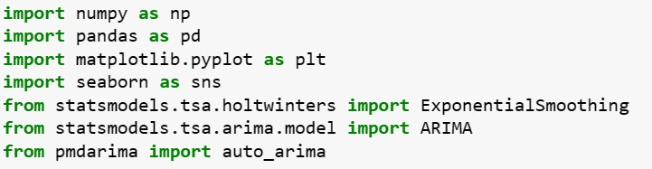
Libraries Used:-

Slide 10

Data
Pre-Processing
In Data Pre-processing we replaced NaN values with zeros per product during preprocessing to ensure data consistency and minimize errors in the dataset.

Slide 11

Using
Statistics

Slide 12
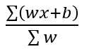
Statistics - weighted average
Average accuracy and BIAS has been calculated for each product based on the accuracies of the predictions from
demand planners, marketing team and the statistics team forecasts over FY2023 Q1, FY2023 Q2, FY2023Q3 .
The equation used to calculate the individual forecasts for every product is :-
W:average accuracy over the previous years
B: is the bias.
The accuracy obtained for every department is used as weight for calculating the final sales value.
Data from FY2023 Q1, FY2023 Q2, FY2023 Q3 has been taken into consideration for carrying out the computations.
Final expression for predicting the number of units sold is given as:-
Insights
Preference given to recent data over older data
The weighted average helped to account for the variability in the accuracy of predicting the sales data by different departments

Slide 13
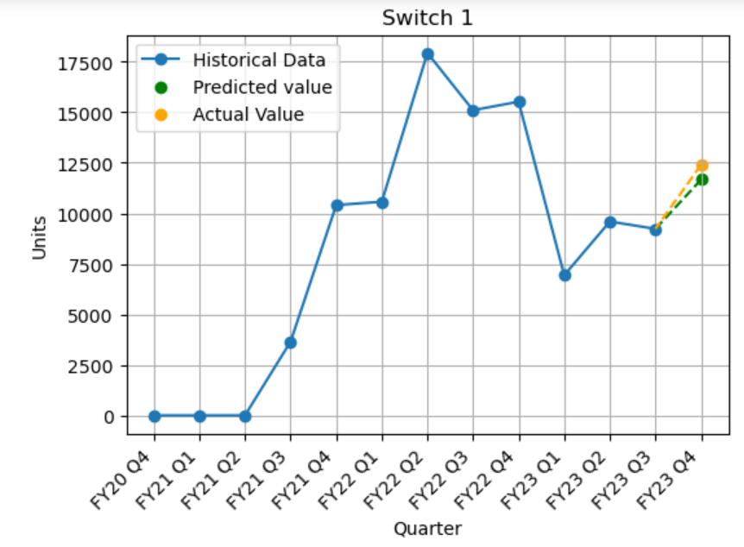
Statistics - weighted average
Observation
The final average is more descriptive than a simple average since it reflects relative importance of each observation
Conclusion
This is a versatile model that can make predictions by taking into account importance, frequency and recency of datapoints

Slide 14

ARIMA

Slide 15
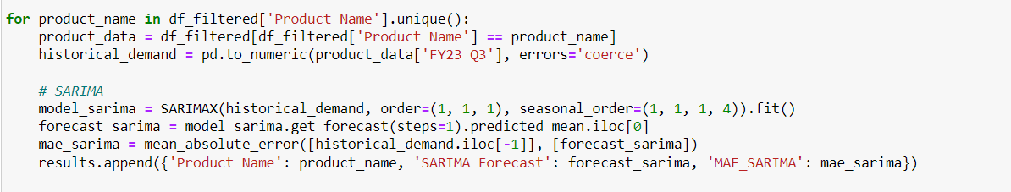
ARIMA takes into account the past values (autoregressive, moving average) and predicts future values based on that.
SARIMA similarly uses past values but also takes into account any seasonality patterns.
Since SARIMA brings in seasonality as a parameter, it’s significantly more powerful than ARIMA in forecasting complex data spaces containing cycles.

Slide 16

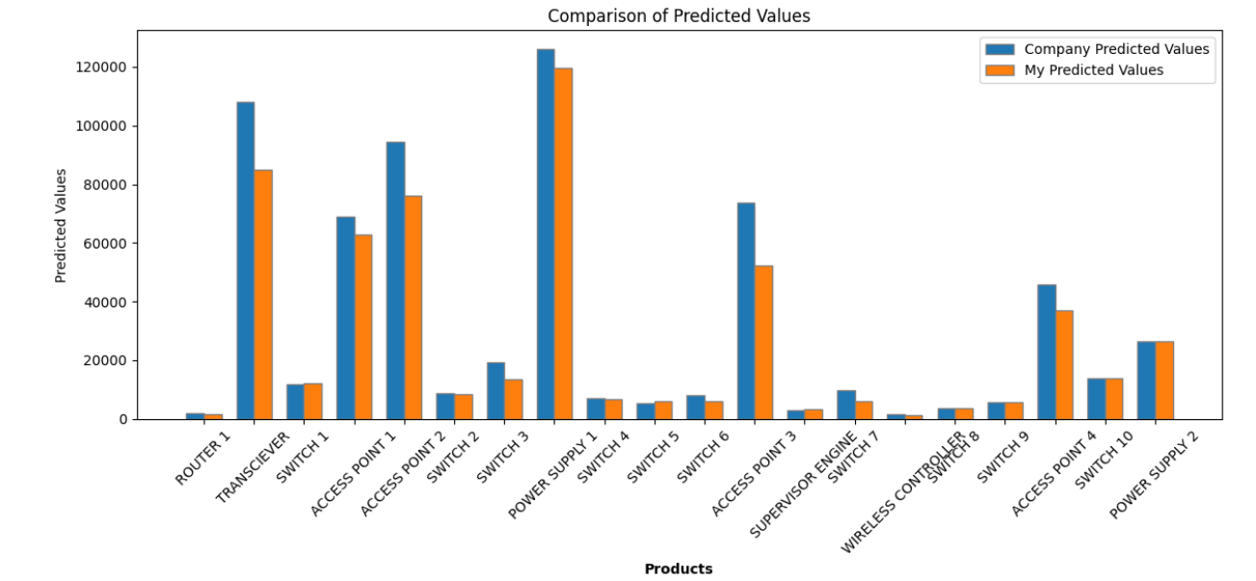
Forecast Using ARIMA

Slide 17

Holt’s exponential smoothing

Slide 18
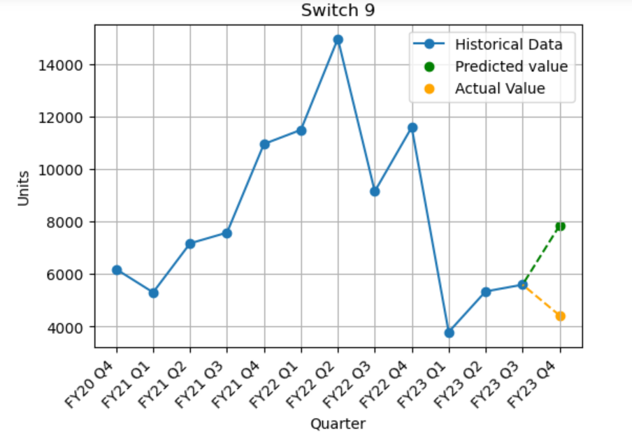
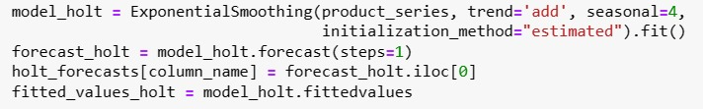
Switch 9 experienced peaks in F’21 Q4 and F’22 Q4. There was a decline noted in F’23 Q2. However, the actual value for F’23 Q3 exceeded predictions.
As it can be seen this technique is not very accurate for non linear trends

Slide 19

Arriving at results

Slide 20
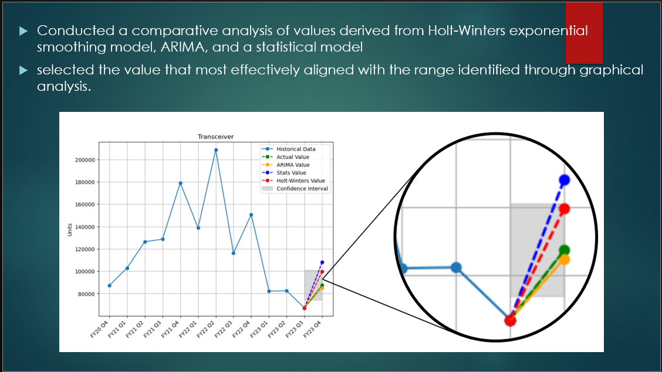

Slide 21
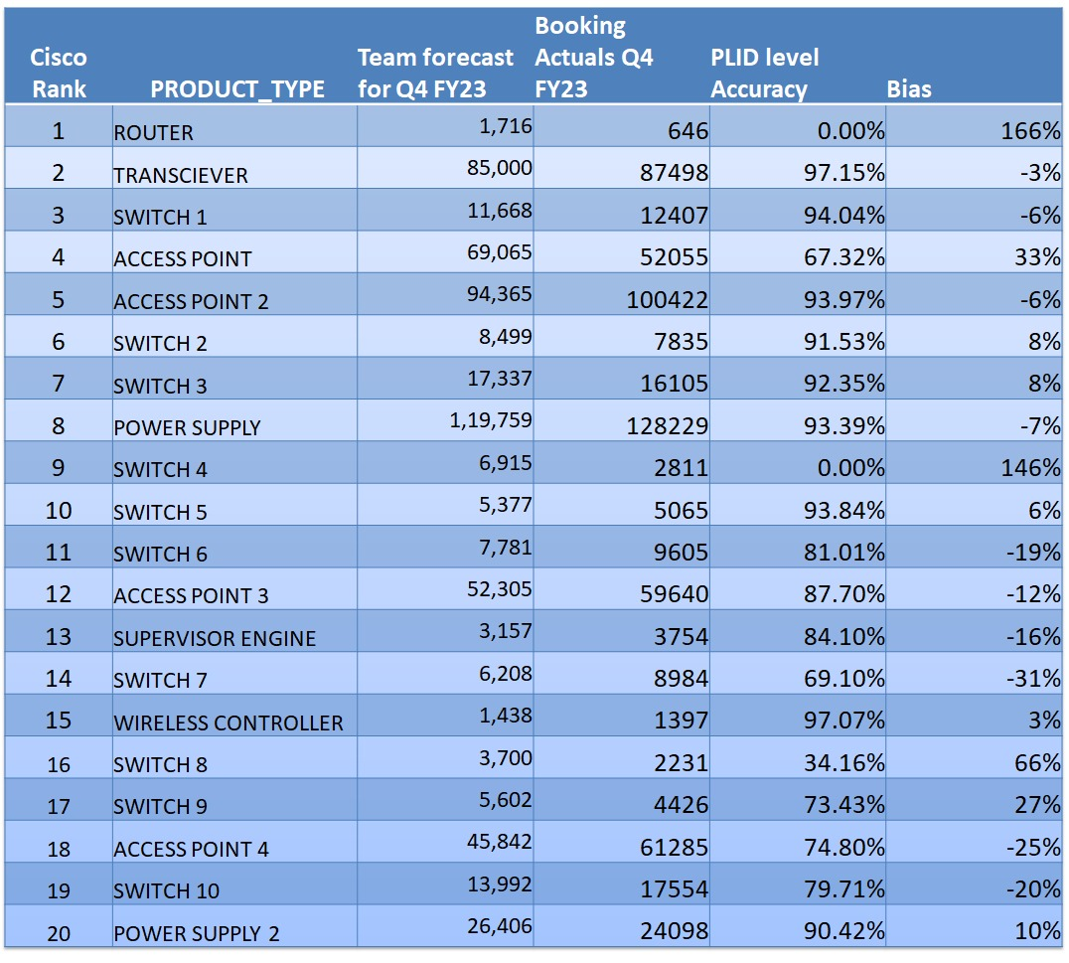

Slide 22

Business Analytics

Slide 23
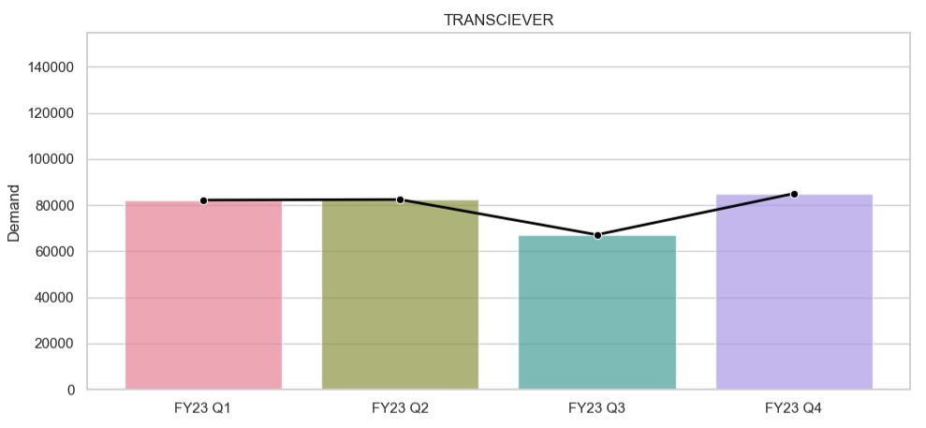
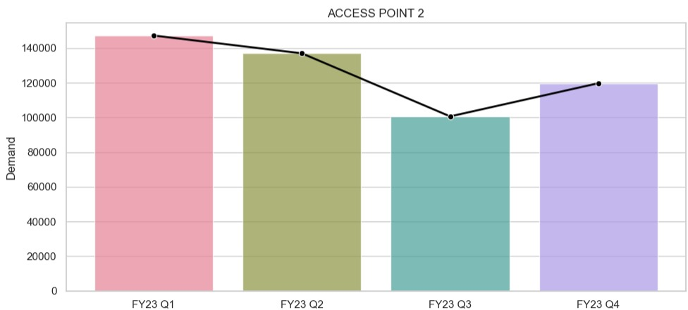
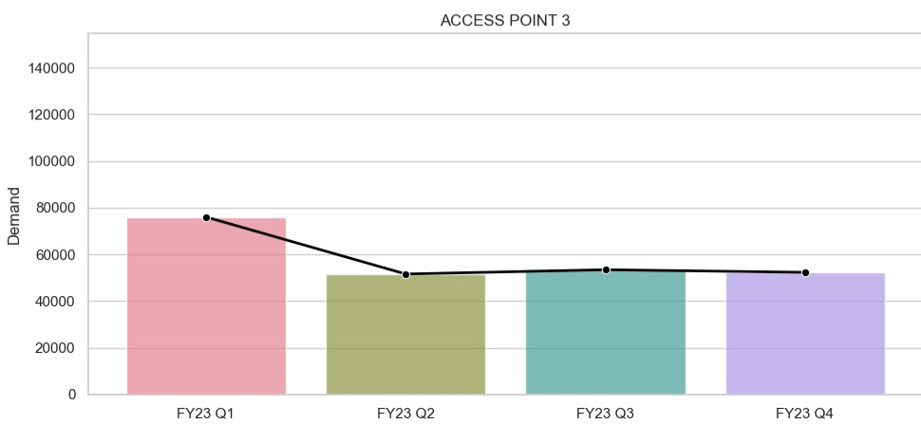
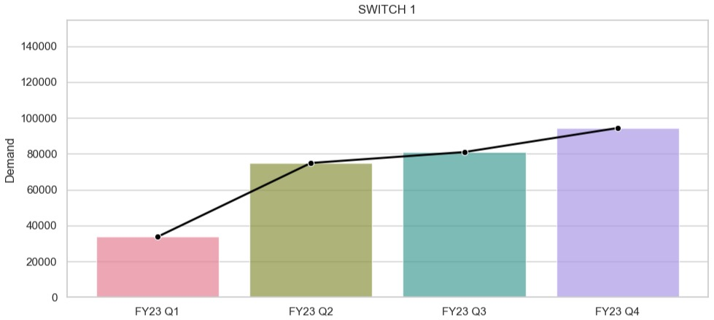
Quarterly Trend Analysis
Transceiver
Access point 2
Access point 3
Switch 1

Slide 24
Quarterly Trend Analysis

Slide 25
Business Insights from Data Analyzed
High Accuracy Predictions:
Continue refining the model for further improvement.
Optimize operations based on forecasted demand.
Maintain vigilant monitoring of trends for adjustments.
Use forecasts for long-term strategic planning.
Lower Accuracy Predictions:
Collaborate with marketing and demand planning departments for insights.
Augment data with additional sources for better analysis.
Develop contingency plans for unexpected fluctuations.
Consider model iteration or alternative approaches for improvement.

Slide 26
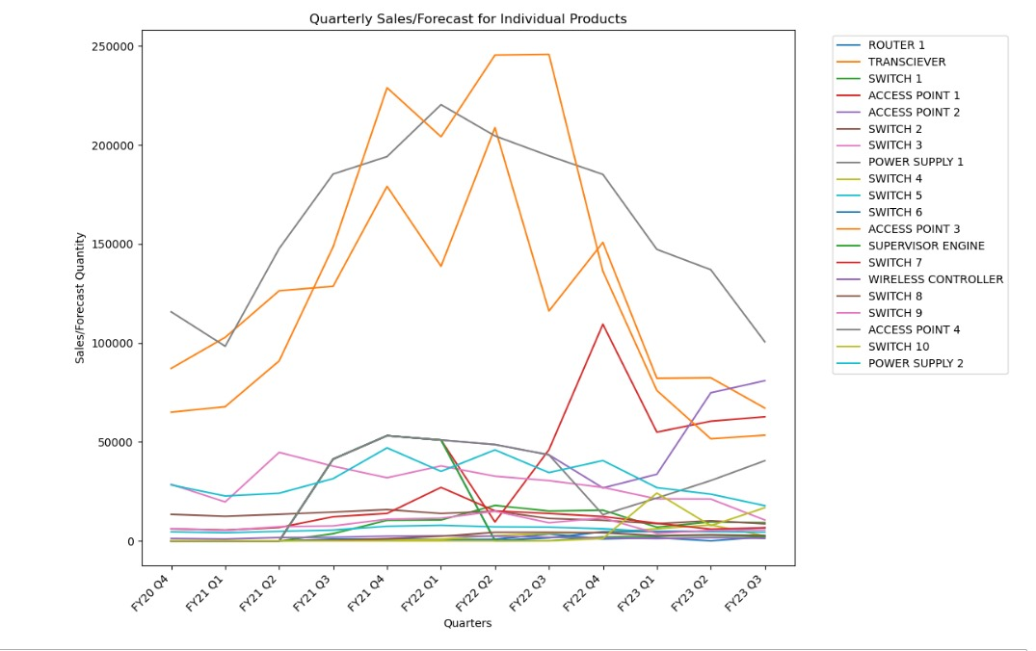

Slide 27
Analyzing Product Trends: Study individual product patterns.
Spotting Outliers: Identify products with significant variations between actual and predicted values. Investigate reasons like promotions, external events, or supply chain issues.
Opportunities for Enhancement: Gather user feedback and involve the R&D team to research and enhance model quality.
Strategic Decision-Making: Inform inventory management, production planning, and resource allocation strategies.
Effective Communication and Collaboration: Foster teamwork and open communication channels for seamless coordination.

Slide 28

Conclusion
In conclusion, we have attained an impressive overall accuracy of 81.002%. The accompanying graph illustrates the product-wise accuracy in comparison to the accurate results provided by the company

Slide 29
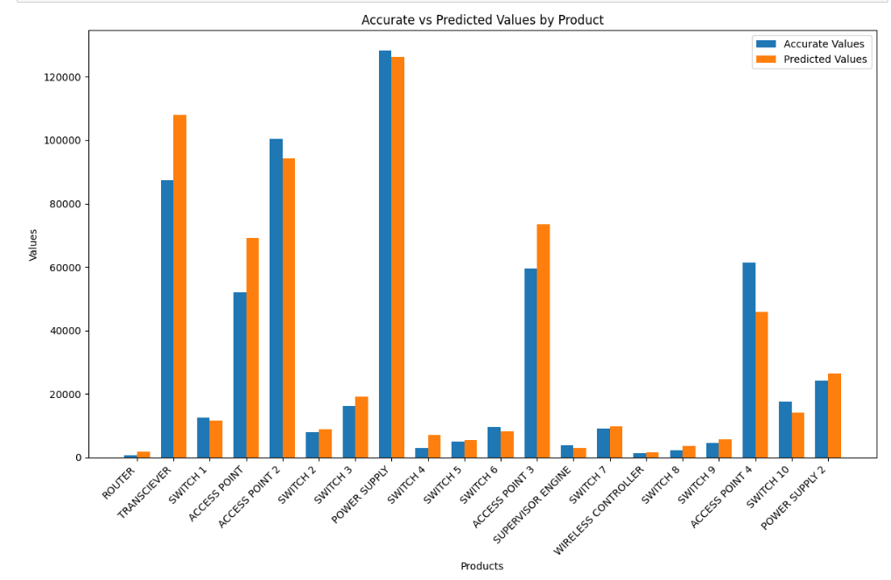

Slide 30

Thank you

